Slide 1
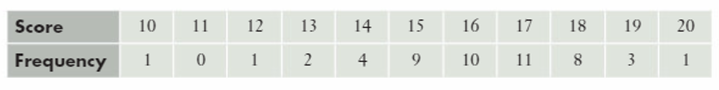
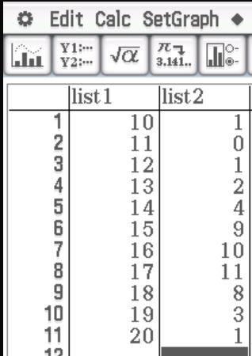
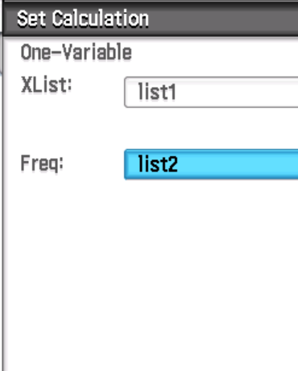
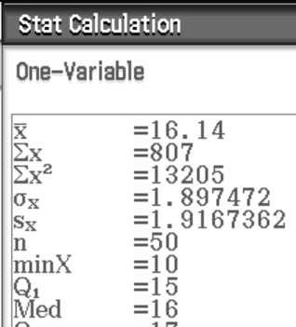
Standard Deviation using Frequency Tables
If data is given in the form of a frequency table, we can still enter it into our ClassPad (setting frequency as list 2).
The mean is 16.14 and the standard deviation is 1.90 (to 2dp).

Slide 2
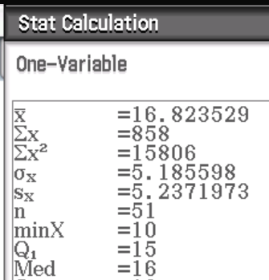
Standard Deviation and Outliers
Sometimes we have data values that are really far away from the others (known as outliers). These can have a big effect on the standard deviation (and sometimes the mean) of a data set.
Using the same frequency table as last time, but with an additional score of 51.
The mean is now 16.82 but the standard deviation is now 5.19!
We need to be careful with outliers. Sometimes we might calculate the standard deviation without including the outlier and comment on its presence.
Sometimes the outlier might be what we are looking for! If we were testing medicines to see the effect they have on a disease; the medicine with significantly different results might be the one we want to use.

Slide 3
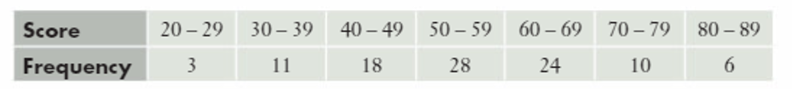
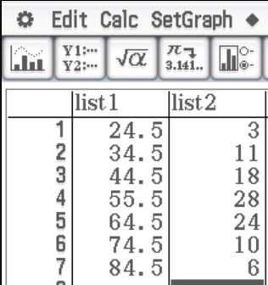
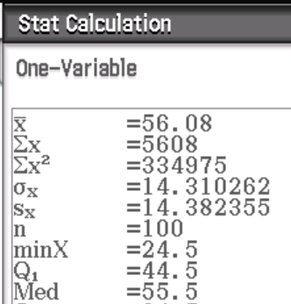
Standard Deviation and Grouped Data
Now do Exercise 3C
To estimate the mean for grouped data, we used the midpoint of the group.
We do the same to estimate the standard deviation.
Our estimated mean is 56.08 and our estimated standard deviation is 14.31 (to 2dp).

